Slide 1
Annual Meeting Cameron Pond Community Association
January 22ND, 2020

Slide 2
Key Accomplishments of 2019
Monument renovation and restoration
Pool attendant wrap-up / Lifeguard vote
New pool management company
Pool security cameras
Walk-thru common areas
New mailbox design approval
Approved just over 30 ARC requests
New mailboxes design
Five community social events
Poolside chats to informally meet with board members

Slide 3
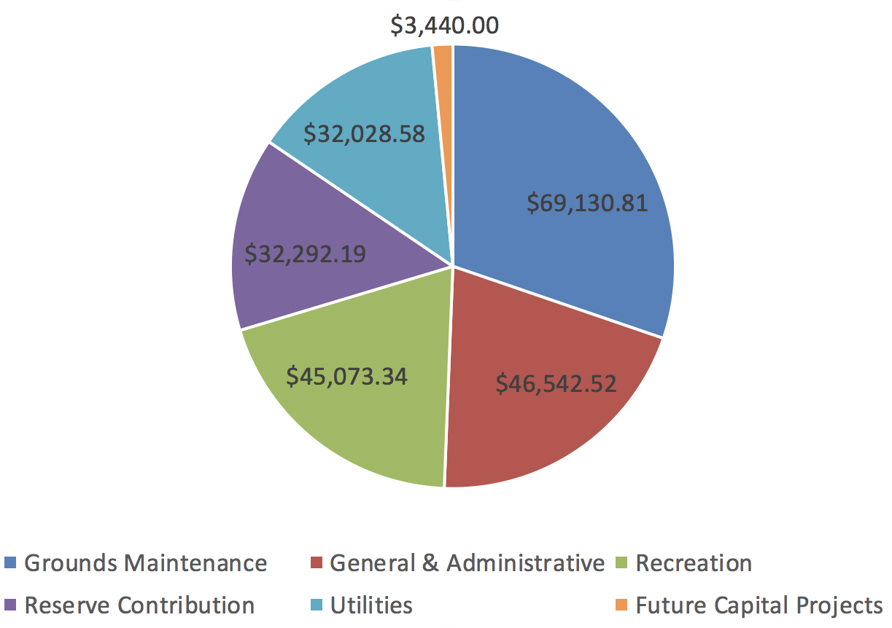
2019 Spending to Date
Notes
Grounds Maintenance activities still pending:
Pine straw application - $18K

Slide 4
Cameron Pond Priorities for 2020
Complete new monument signs on Shires entrance
Redesign landscaping around main entrance monuments
Enhance landscaping at roundabouts
Retention pond repairs
Replace pet waste stations as needed
Install new pool security cameras
Pool parking lot resurfacing and signage
Review security lighting proposals at pool
Continue to be accessible to the community

Slide 5
Communication
Omega Management:
laura@omegamgmt.com
jennifer@omegamgmt.com
Questions for the Board:
www.cameronpond.com
board@cameronpond.com
Connect with Neighbors:
Social Media Sites: Facebook Cameron Pond Group / Nextdoor
Streets in Cameron Pond: Town of Cary

Slide 6
Thank You

